Slide 1
Unit 8
Slope and Rate of Change
Integrated Mathematics 9

Slide 2
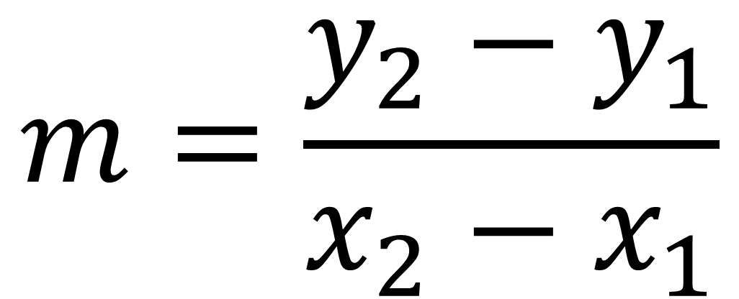
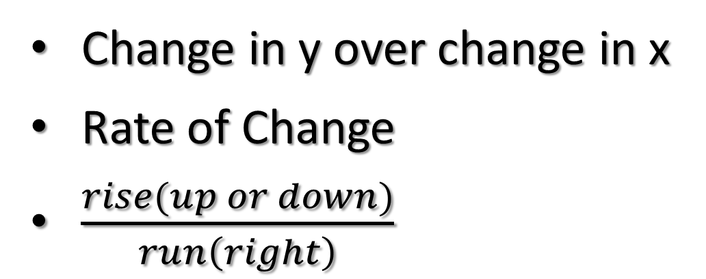

Slope
Change in y over change in x
Rate of Change
$\frac{rise(up or down)}{run\left(right\right)}$
$$m=\frac{y_{2}−y_{1}}{x_{2}−x_{1}}$$
Where $\left(x_{1},y_{1}\right) and {(x}_{2},y_{2})$

Slide 3


FIND THE SLOPE
$$\left(4,−7\right) \& (−5, 5)$$
$$\left(−5, 2\right) \& (3,−1)$$

Slide 4


FIND THE SLOPE
$$\left(6,−1\right) \& (0, 8)$$
$$\left(4,−2\right) \& (−9, 11)$$

Slide 5


FIND THE SLOPE
$$\left(−2, 3\right) \& (−3, 0)$$
$$\left(12, −4\right) \& (0, 6)$$

Slide 6
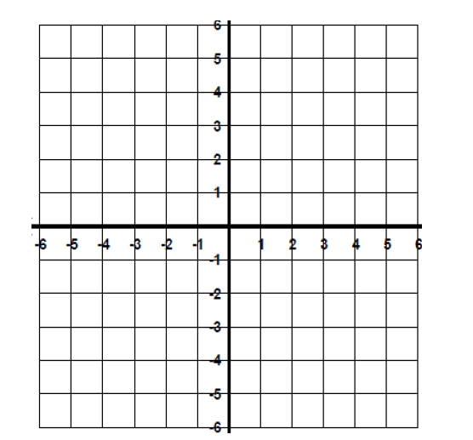
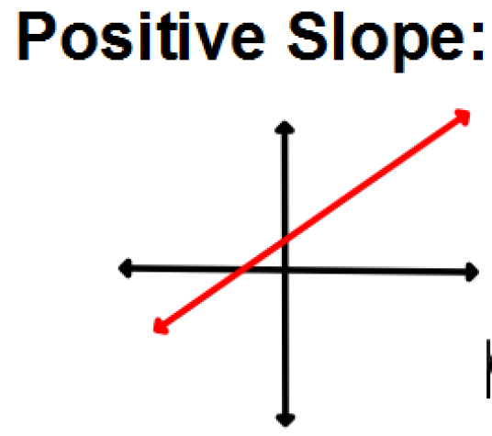
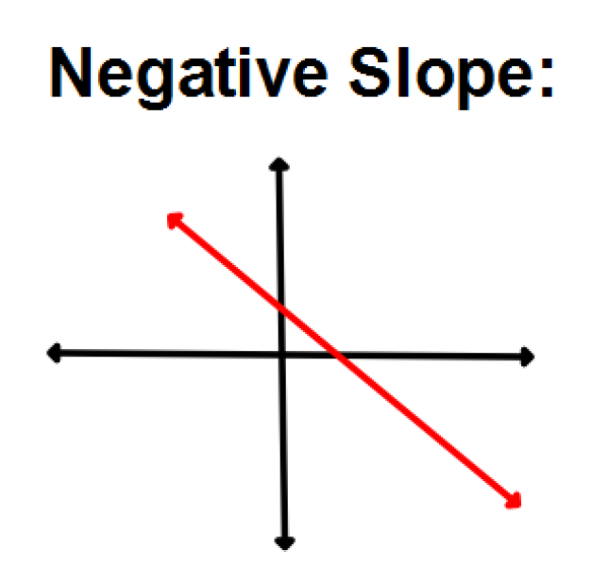

FIND THE SLOPE

Slide 7
When y = #, the slope is 0. The graph is a horizontal line ( Left and Right )

Slide 8
When x = #, the slope is UNDEFINED and the line is vertical ( up and down)

Slide 9
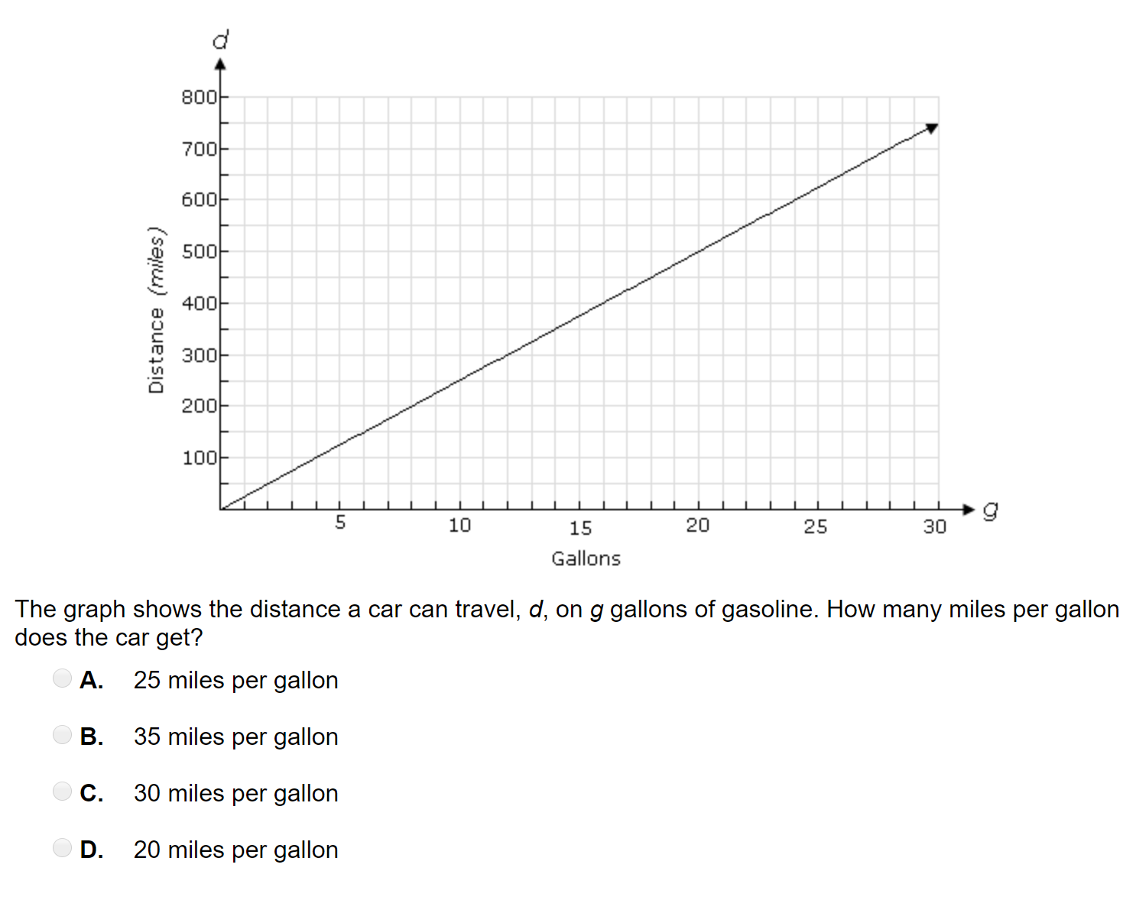

Slide 10
